Slide 1

Laws and Regulation
That pertain to Cybersecurity and Infosec

Slide 2
Schedule
Today = main laws
Thursday = compliance and data privacy protections

Slide 3
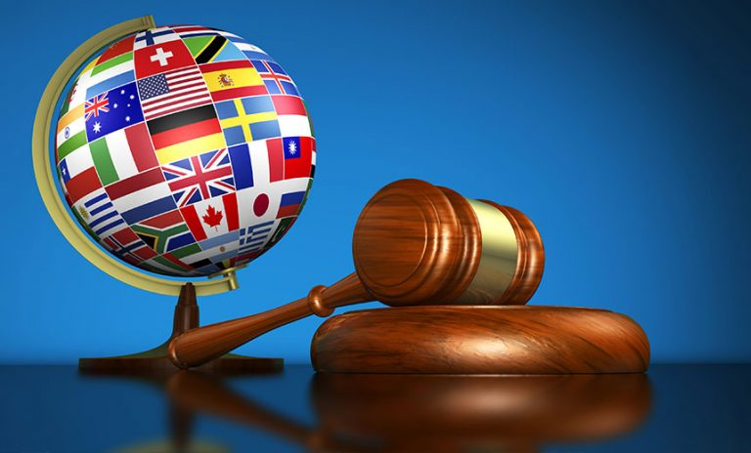
Topics
International Law
State Laws
Federal Laws and Regulation
This Photo by Unknown Author is licensed under CC BY-NC-ND

Slide 4

International Law
Why (esp. today) do we care about international law?

Slide 5

Meta vs. Microsoft
Meta
12 Domestic Offices – biggest Palo Alto, CA
14 International – London, UK or Hamburg, Germany
Microsoft
116 US – 8 in FL
204 International – when I worked there

Slide 6
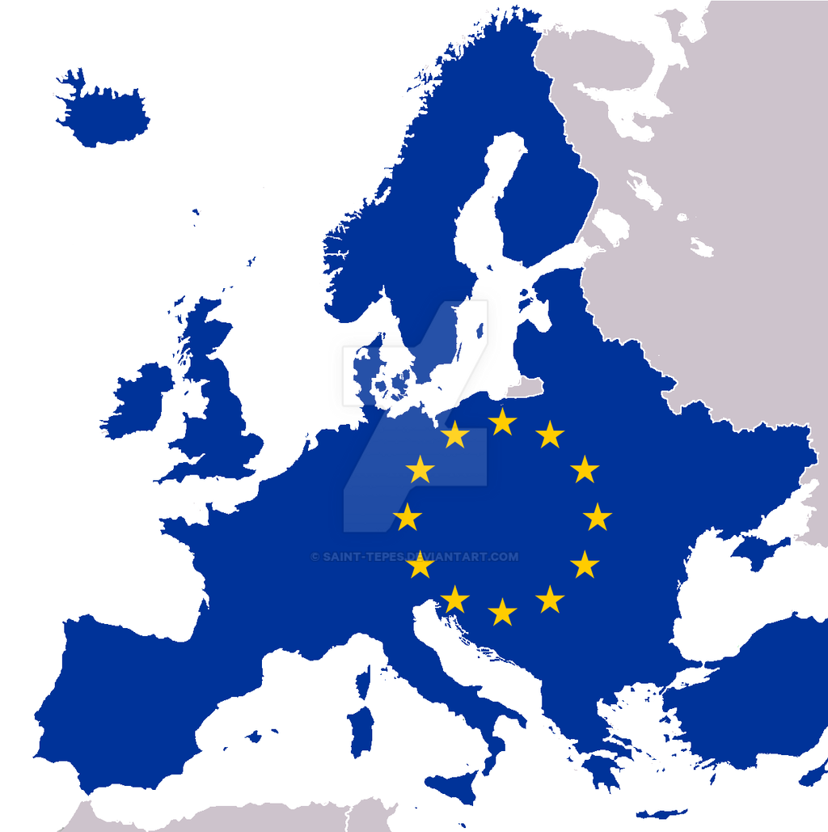
International Law is messy but also Easier
GDPR (General Data Protection Regulation) is European Union
I’m ignoring other countries (which vary but are not as strict as GDPR)
Why am I starting with the GDPR (first) then?
Even with US companies I start with this when performing an assessment.
This Photo by Unknown Author is licensed under CC BY-SA

Slide 7

GDPR Check
Is the data about individuals physically in the European Union (EU) at the time of collection?
Does the data include personal identifiable information (PII) or sensitive personal information (PI)?
PII includes national identification number, date of birth, address, photos, cookie IDs, exam info, and more
PI includes racial or ethnic origin, religion, medical info, sexual orientation

Slide 8

In a nutshell
Expands personal privacy rights for EU residents and affects non-EU citizens located in the EU.
Mandates a baseline set of standards for organizations that handle certain personal and other data of individuals located in the EU to better safeguard the processing and movement of that data.
Applies to institutions with no physical EU presence if they control or process covered information (irrespective of whether the subject individuals are EU citizens).
Calls for fines of up to 4% of annual global turnover, or 20 million euros, whichever is more, for violations of the regulation.
$22 mil US

Slide 9
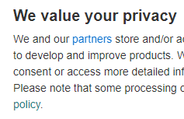
Main Points
Lawful processing of personal data. The GDPR requires that personal data be processed lawfully, fairly, and in a transparent manner in relation to the data subject.
Data subject rights. Data subjects have a number of rights under the GDPR, including the right to see information about the processing of their personal data, obtain access to own personal data, and request that the data be corrected or erased.
Contract management. The program maintains addenda regarding GDPR compliance to include in contracts with third-party providers that collect and/or process personal data.
Data breach management. In the event of a breach of personal data covered by the GDPR, the program has the responsibility for notifying data protection authorities and data subjects as outlined in the GDPR.
Education and outreach. The program stipulates companies regularly engage in activities and outreach in support of privacy protection.
No Federal law,
yet….

Slide 10

Now State
Wait, what was the reason for GDPR first? Why state first?

Slide 11
CCPA – California Consumer Privacy Act of 2018 & 2020
Keyword
CCPA
Right to know
Right to delete
Right to opt-out
Right to non-discrimination
CCRA (CCPA Ratified Amendment added)
Right to correct
Right to limit
Like GDPR
Essentially Same

Slide 12
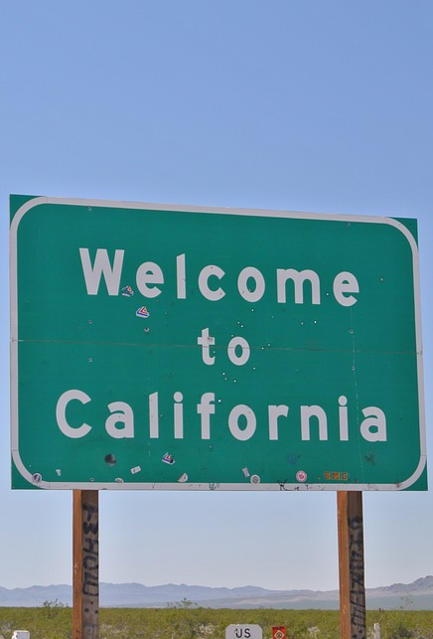
Why’s it matter? Top states for Tech companies!
California (#1 since the 90s)
By more than 15k workers in all polls
New York
Virginia (*cough* Microsoft)
With some data points:
Washington (D.C. not the state) actually tops Virginia
Texas was in 2nd then some layoffs happened and now 4^{th-ish}
Dallas has around 60% of these jobs
Florida is 5th or 6th depending on poll (IL is other)
IL is pulling ahead as “back to the office” pulls people out of FL

Slide 13
Other states who have similar protections
New York (#2)
Virginia (#3)
Illinois (#4-5)
Texas (#4-5th)
Florida (updated Florida Privacy Act of 1864 & Florida Information Protection Act of 2014 last session, i.e. February)

Slide 14
Federal Law
So, the US doesn’t (yet) have a data breach protection or national consumer protection

Slide 15

SEC – Securities and Exchange Commission
Do not have a law on the books (yet) for reporting data breaches
They are the ones who determine fines though including (to pick on 2 of the worst):
Target’s 2013 breach of 40 million consumer’s data – 100 million fine (not including 3.8% loss of sales during December)
Yahoo ? To 2014 data breach of 3 billion users - $35 million fine for not disclosing (found out during Verizon merger) and took off $350 million in said merger

Slide 16

SEC learned from this and now may see that law
Set to be on the books by May
Adds regulations specific to data breaches
Including higher (set) fines for them occurring
Set fines for non-disclosure
Closer to GDPR language in several privacy places

Slide 17
Take-away
What does this mean for corporations or security?
Esp. re: CIA

